Slide 1
Salaries by college
Degrees that pay back
Salaries by region
Clean(replace “$” and “,” and convert to float
Cleaned data
Create subset to keep only required variables
Create subset to keep only required variables
Subset
Assign rank based on starting median salary and mid career median salary
creating subset Data frame(school type)
Data frame with ranks.
Plot four bar charts
Based on school type finding average salary
Correlation between mid career median salary & starting median salary
Plot bar chart
Top 10 college (SMS)
Top 10 college(MCMS)
Bottom 10 school(SMS)
Bottom 10 school(MCMS)
Generating the regression line and scatter plot

Slide 2
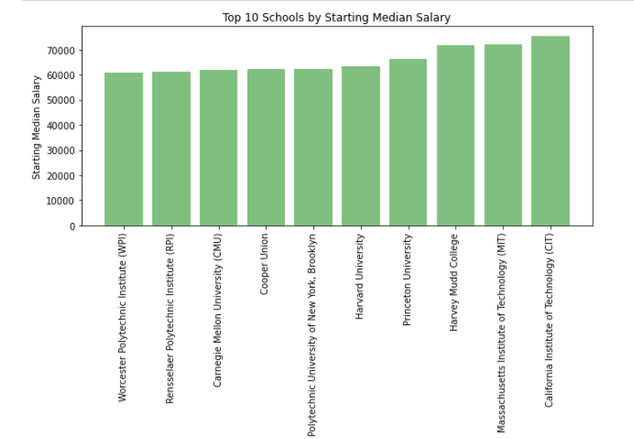
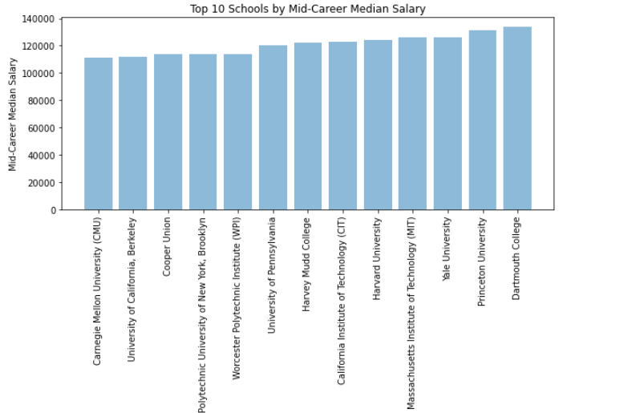
Plot bar chart top 10 school based on starting median salary and mid career median salary

Slide 3
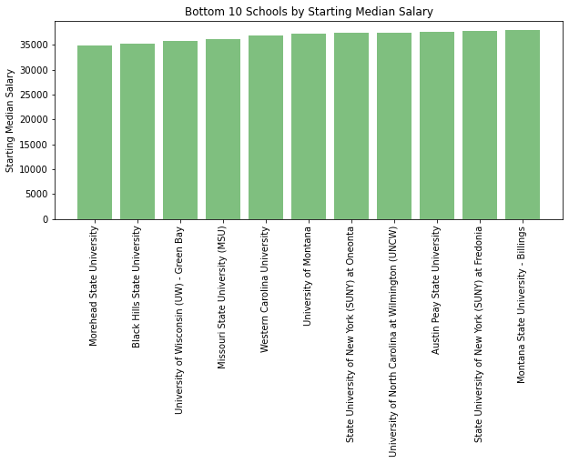
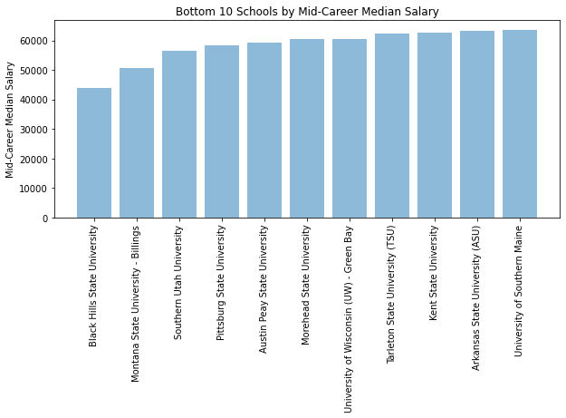
Plot bar chart bottom 10 school by starting median salary and mid career median salary.

Slide 4
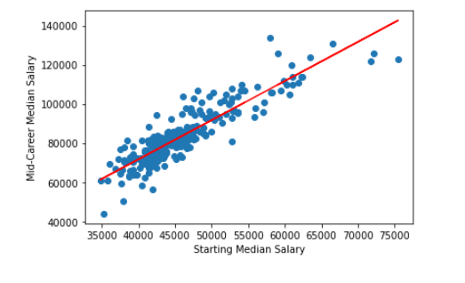
Generating the regression line for plotting
Scatter plot Mid-Career Median Salary Vs Starting Median Salary

Slide 5
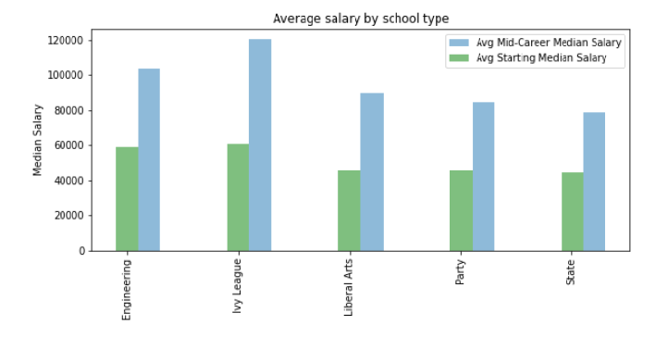
Based on school type finding average salary

Slide 6
Conclusion
Dartmouth College have highest average Mid career median salary and California Institute of Technology have highest average starting career median salary.
Black Hills State University have lowest average Mid career median salary and Morehead State University of Technology have highest average starting career median salary.
There is strong positive corelation (0.89) between Starting median salary and Mid-career median Salary.
Ivy League school type has highest average Mid-Career median salary and average Starting median salary.
State school type has lowest average Mid-Career median salary and average Starting median salary.

